Slide 1
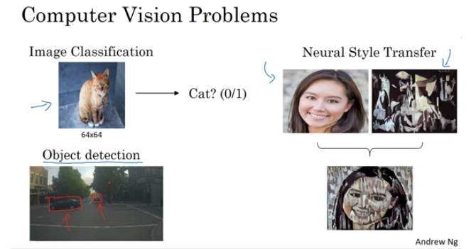

Slide 2
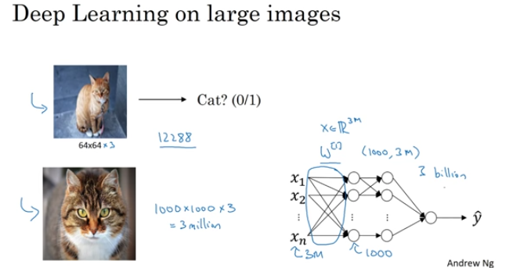

Slide 3
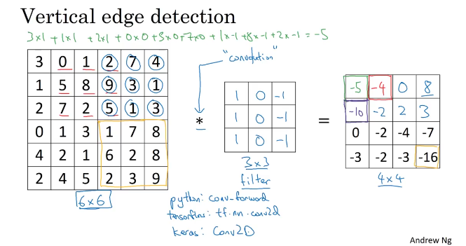

Slide 4
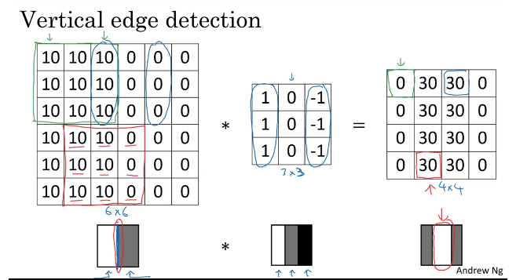

Slide 5
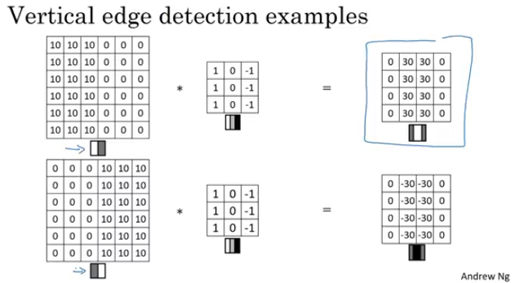

Slide 6
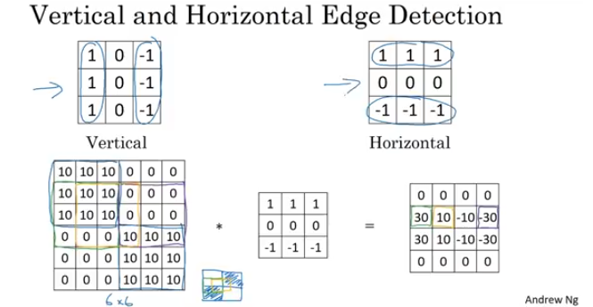

Slide 7
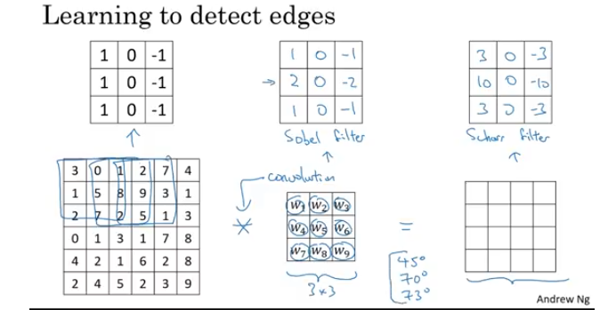

Slide 8
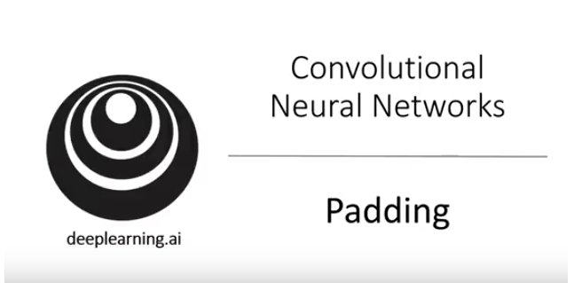

Slide 9
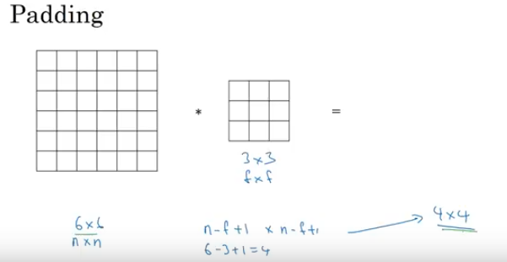

Slide 10
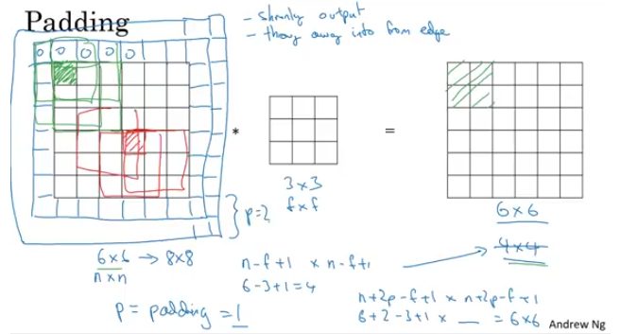

Slide 11
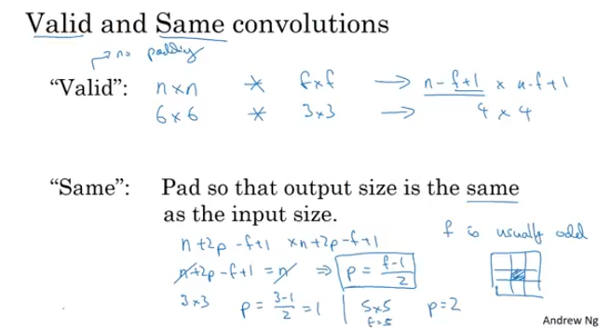

Slide 12
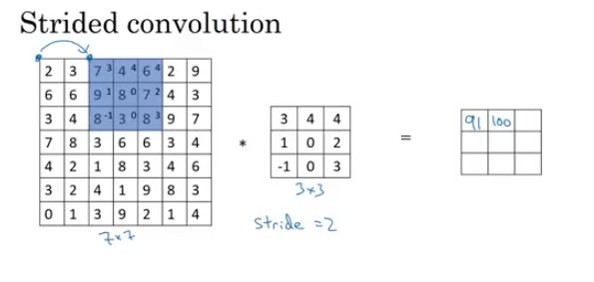

Slide 13
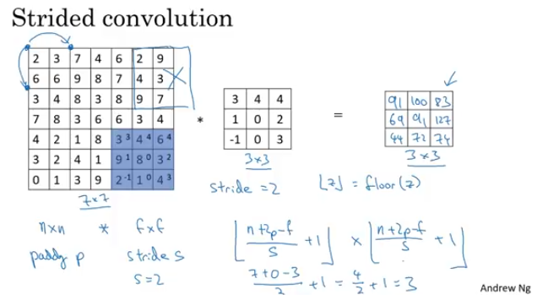

Slide 14
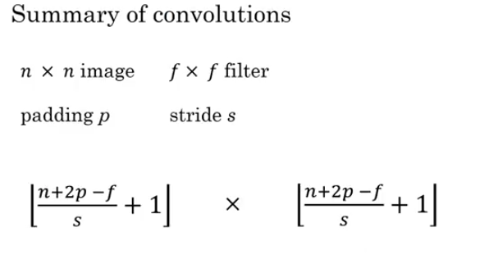

Slide 15
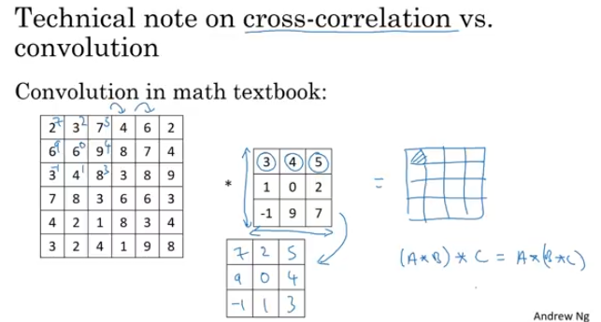

Slide 16
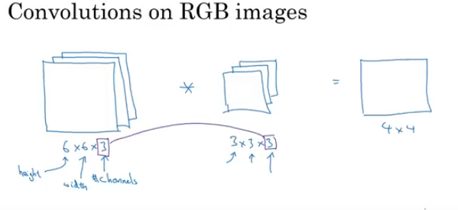

Slide 17
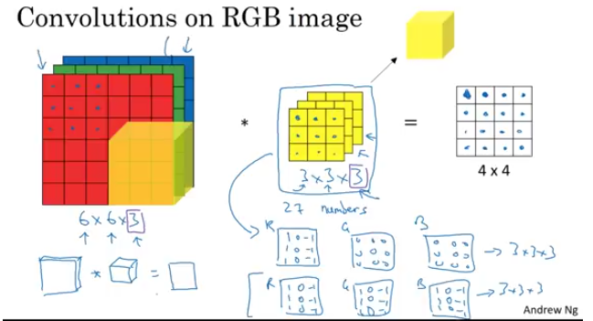

Slide 18
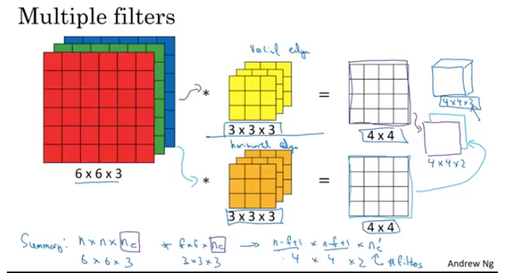

Slide 19
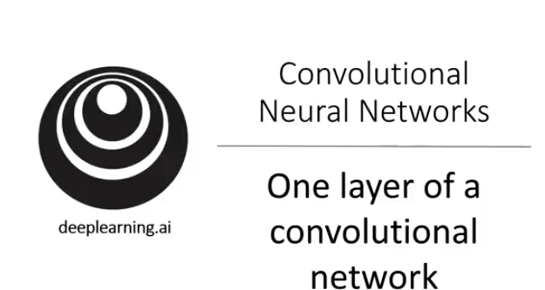

Slide 20
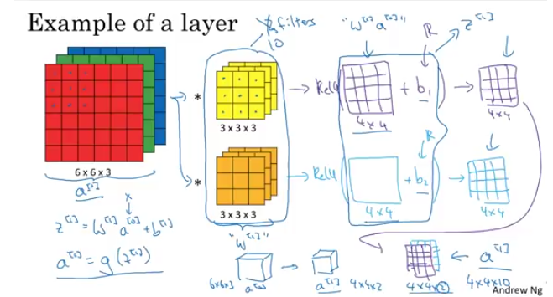

Slide 22
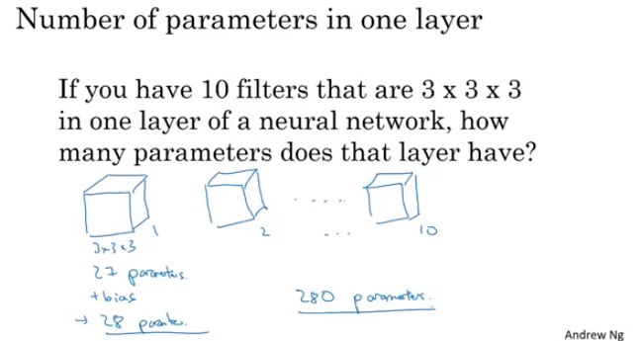

Slide 23
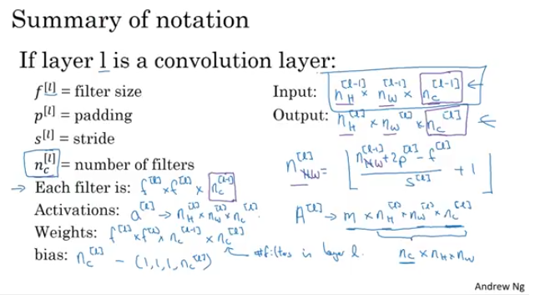

Slide 24
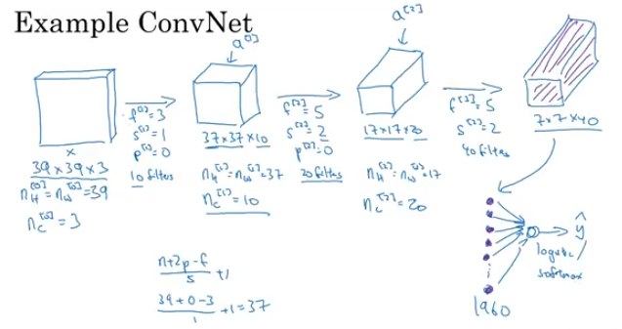
Notes:
General Trend: Image dimension decreases as go deeper in to NN towards final prediction
While number of channels increases as go deeper in to NN towards final prediction

Slide 25
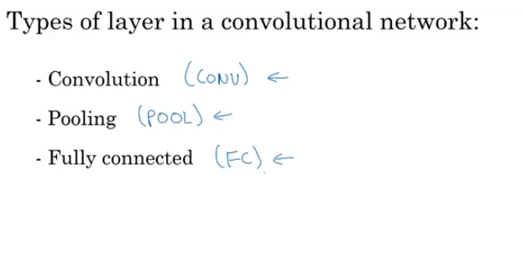
Notes:
Pooling layers added in terms of detection of features robustness and speed.

Slide 26
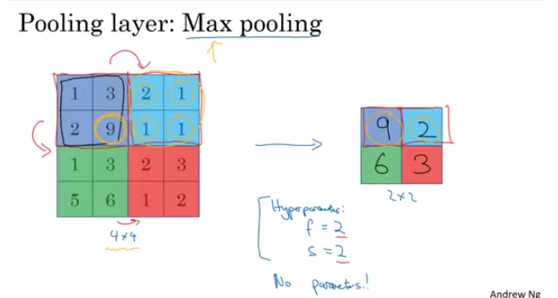
Notes:
Independent layer in output for each layer in input

Slide 27
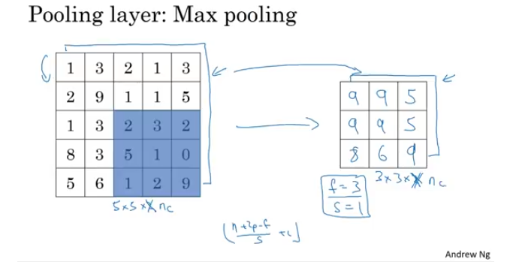
Notes:
Independent layer in output for each layer in input.
Its function is to progressively reduce the spatial size of the representation to reduce the amount of parameters and computation in the network, and hence to also control overfitting. The Pooling Layer operates independently on every depth slice of the input and resizes it spatially, using the MAX operation

Slide 28
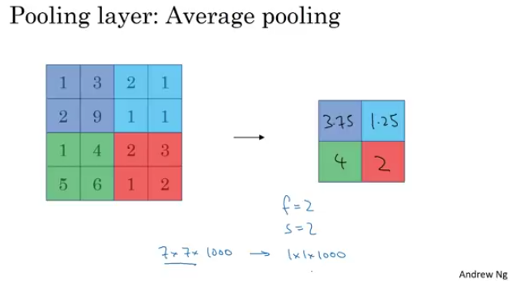
Notes:
Independent layer in output for each layer in input.
Its function is to progressively reduce the spatial size of the representation to reduce the amount of parameters and computation in the network, and hence to also control overfitting. The Pooling Layer operates independently on every depth slice of the input and resizes it spatially, using the MAX operation

Slide 29
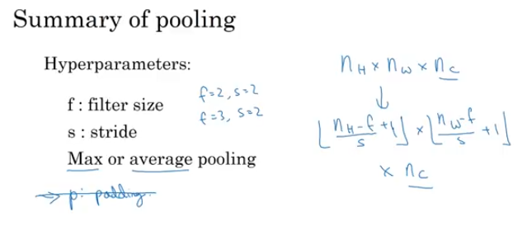
Notes:
Independent layer in output for each layer in input.

Slide 30
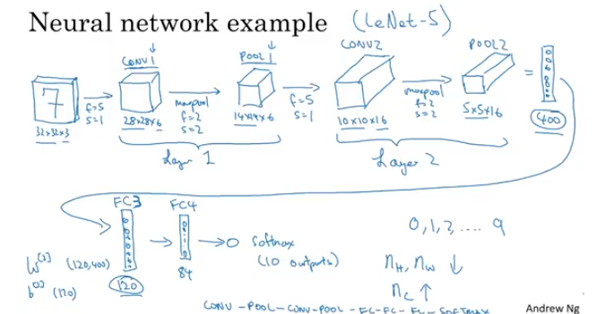
Notes:
Independent layer in output for each layer in input.

Slide 31
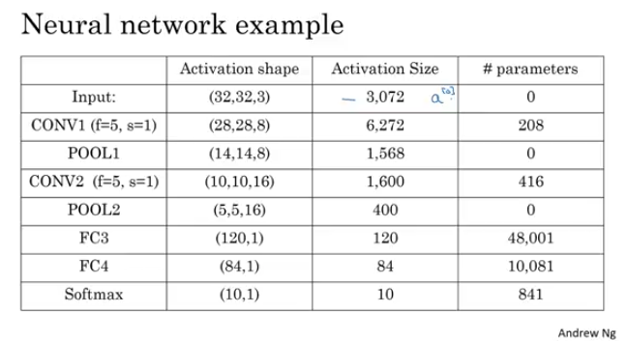
Notes:
Independent layer in output for each layer in input.

Slide 32
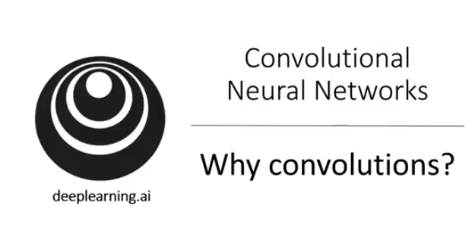
Notes:
Independent layer in output for each layer in input.

Slide 33
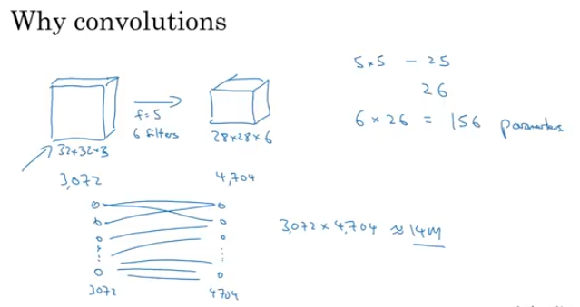
Notes:
Independent layer in output for each layer in input.

Slide 34
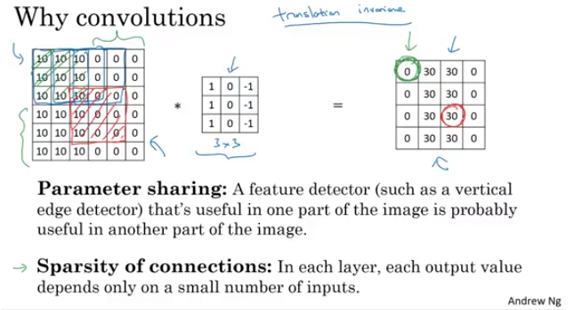
Notes:
Independent layer in output for each layer in input.

Slide 35
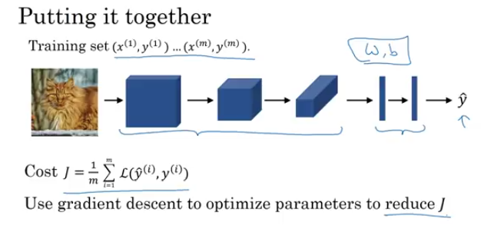
Notes:
Independent layer in output for each layer in input.

Slide 36
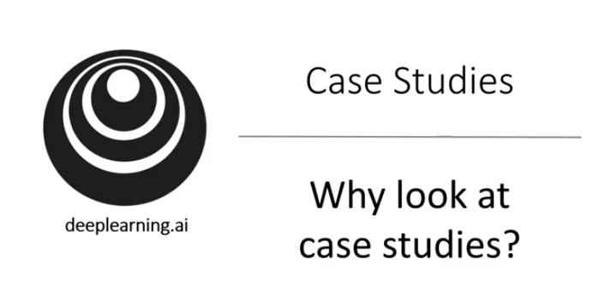
Notes:
Independent layer in output for each layer in input.

Slide 37
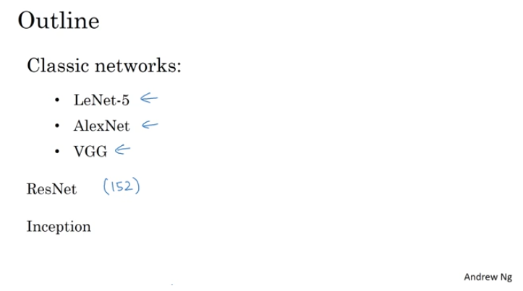
Notes:
Independent layer in output for each layer in input.

Slide 38
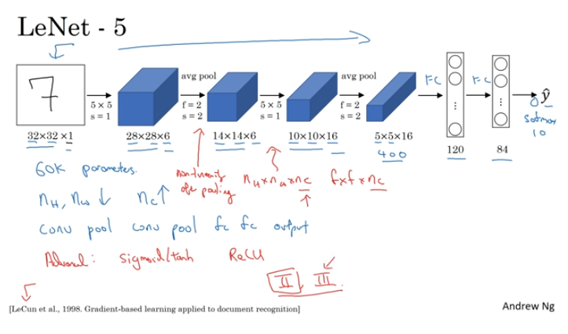
Notes:
Independent layer in output for each layer in input.

Slide 39
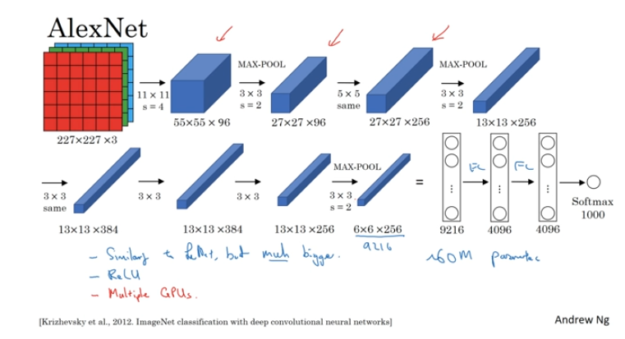
Notes:
Independent layer in output for each layer in input.

Slide 40
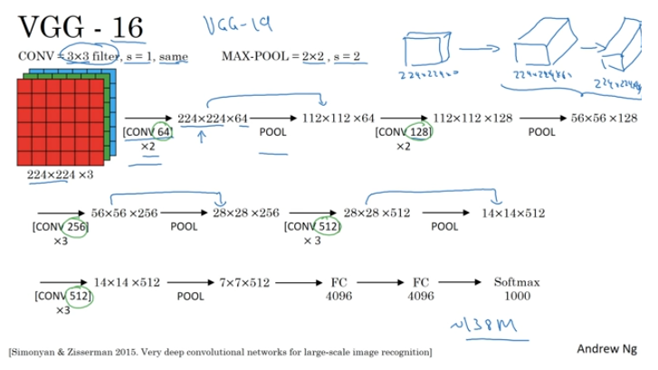
Notes:
Uniform Arcgitecture and more appe

Slide 41
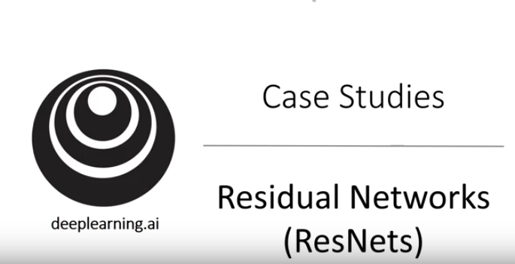
Notes:
FROM Microsoft research

Slide 42
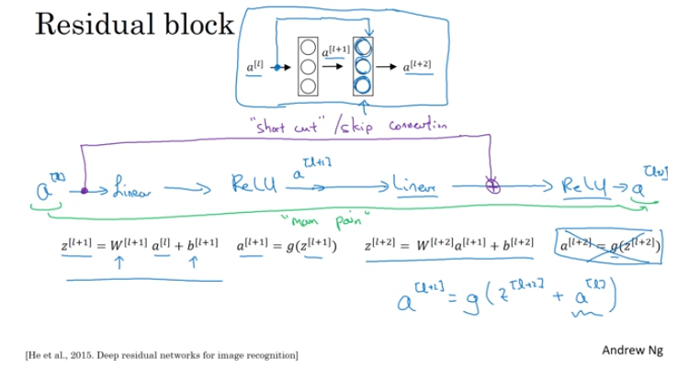
Notes:
Work very much better in case very deep network and remove the problem of vanishing or exploding gradient decent

Slide 43
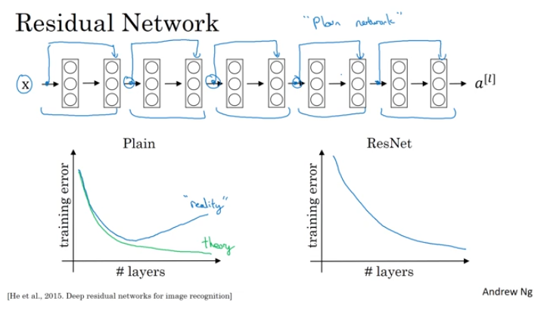
Notes:
Work very much better in case very deep network and remove the problem of vanishing or exploding gradient decent

Slide 44
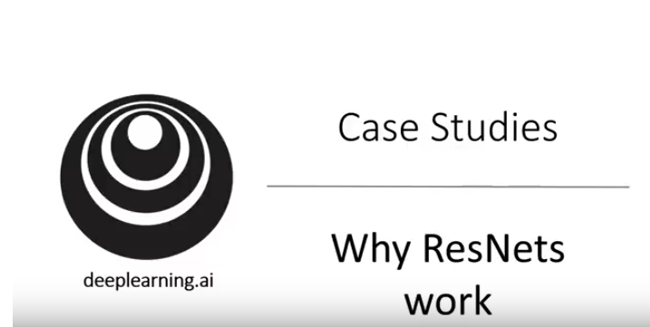
Notes:
Work very much better in case very deep network and remove the problem of vanishing or exploding gradient decent

Slide 45
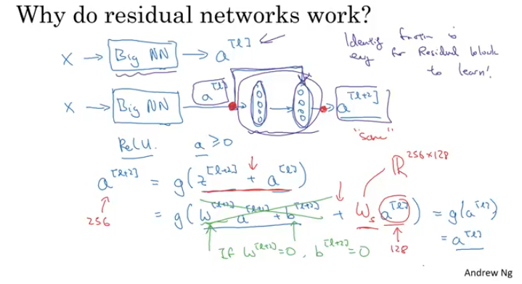
Notes:
Parameter shrinks due to regularization so this complete residual unit work as a identity unit.
To make addition easy for a(l) and a(l+2) ,same convolutions are used.

Slide 46
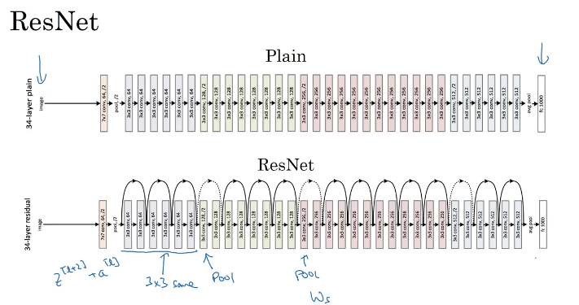
Notes:
Parameter shrinks due to regularization so this complete residual unit work as a identity unit.
To make addition easy for a(l) and a(l+2) ,same convolutions are used.

Slide 47
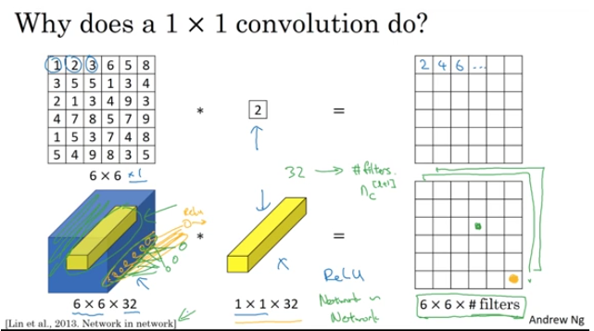
Notes:
Used to shrink number of channels

Slide 48
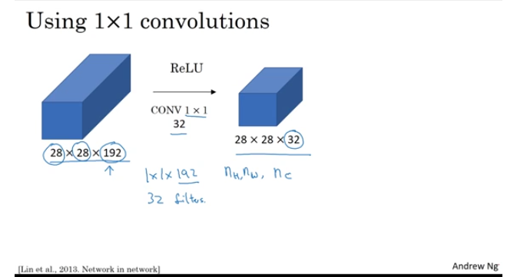
Notes:
To shrink and augment the number of channnels
Can be used to Just To add non linearity to learn more complex functions

Slide 49
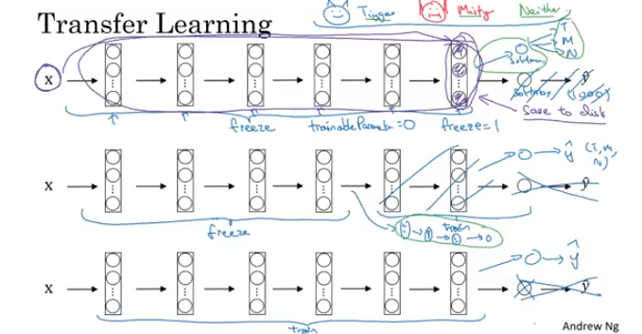
Notes:
Just To add non linearity

Slide 50
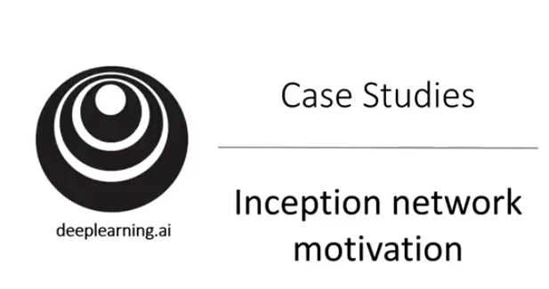
Notes:
Just To add non linearity

Slide 51
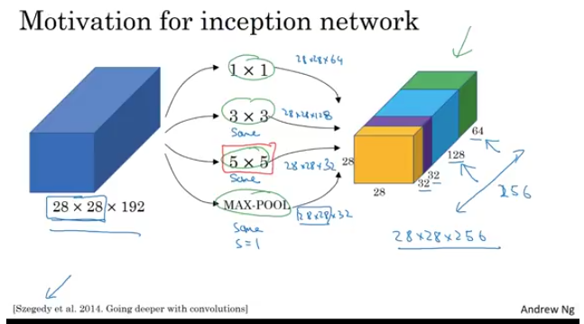
Notes:
Problem is computational cost

Slide 52

Notes:
Just To add non linearity

Slide 53

Notes:
Just To add non linearity

Slide 54

Notes:
Just To add non linearity

Slide 55

Notes:
Just To add non linearity

Slide 56

Notes:
Just To add non linearity

